Slide 1


Slide 2
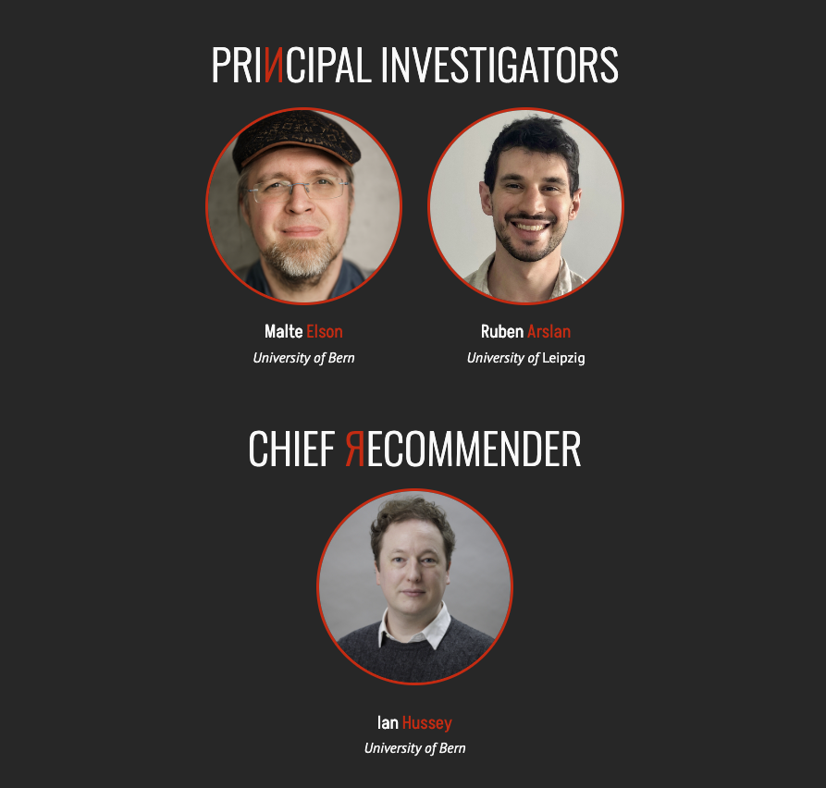
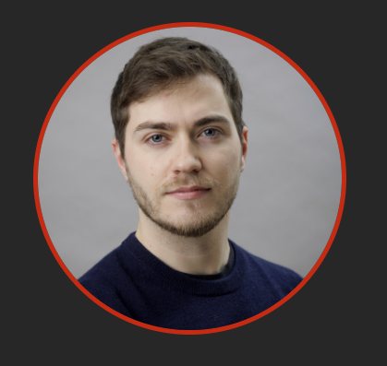


Slide 3
“Like technology companies, stakeholders in science must realize that making error detection and correction part of the scientific landscape is a sound investment.”
Elson & Stapel (2024) Nature

Slide 4
Replications are expensive
Original study
Replication study

Slide 5
Replications are expensive
Error inspections can be a useful prior step
Original study
Replication study
[serious errors]

Slide 6
We ask too much of peer-review
X
One-shot, little redundancy
Despite imperfect reliability & evolving knowledge
X
Generally non-technical
X
Surprising little error checking
for an industry built on discovering truth

Slide 7
Make it easy
Develop new methods and tools to make
error detection and trustworthiness assessment easier
01.
02.
Make it normative
Master’s degree course in error detection
03.
Make it rewarding
ERЯOR: A bug bounty program for science

Slide 8
Make error detection
easier
01.

Slide 9
01.
Error / trustworthiness checks
Expertise problem
Beck Depression Inventory (BDI-II)
N = 23, M = 20.70, SD = 3.40

Slide 10
01.
Error / trustworthiness checks
Information that is repeated or overlooked
Granularity tests
N = 2, Mean age = 25.3
GRIM & GRIMMER (Brown & Heathers, 2016; Anaya, 2016; Allard, 2018)

Slide 11
01.
Error / trustworthiness checks
Information that is repeated or overlooked
Granularity tests
N = 2, Mean age = 25.3
Bounds tests
1-7 Likert scale, M = 8.11
Hinted at in SPRITE (Heathers et al., 2018; Wallrich, 2021)

Slide 12
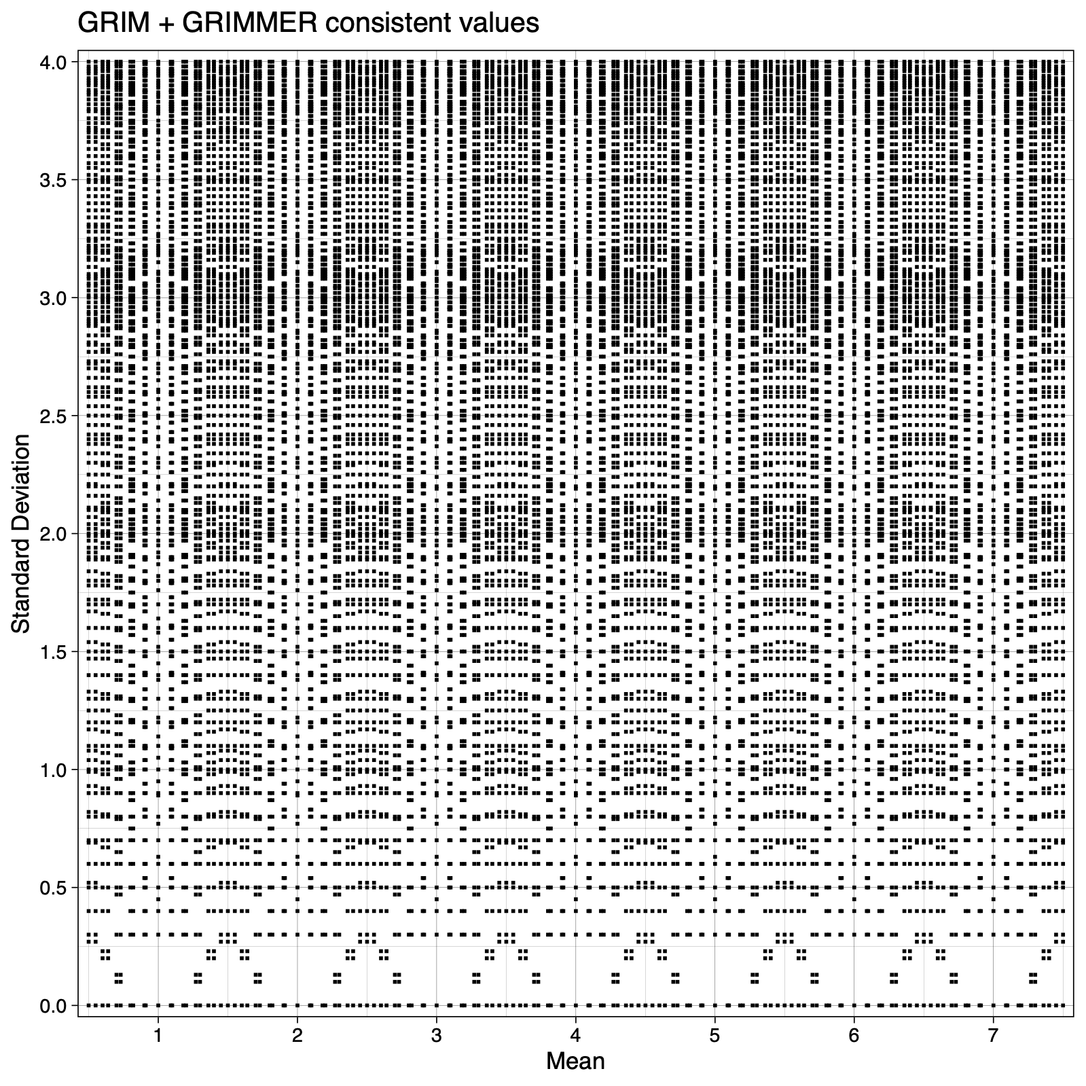
01.
Granularity tests
N=11

Slide 13
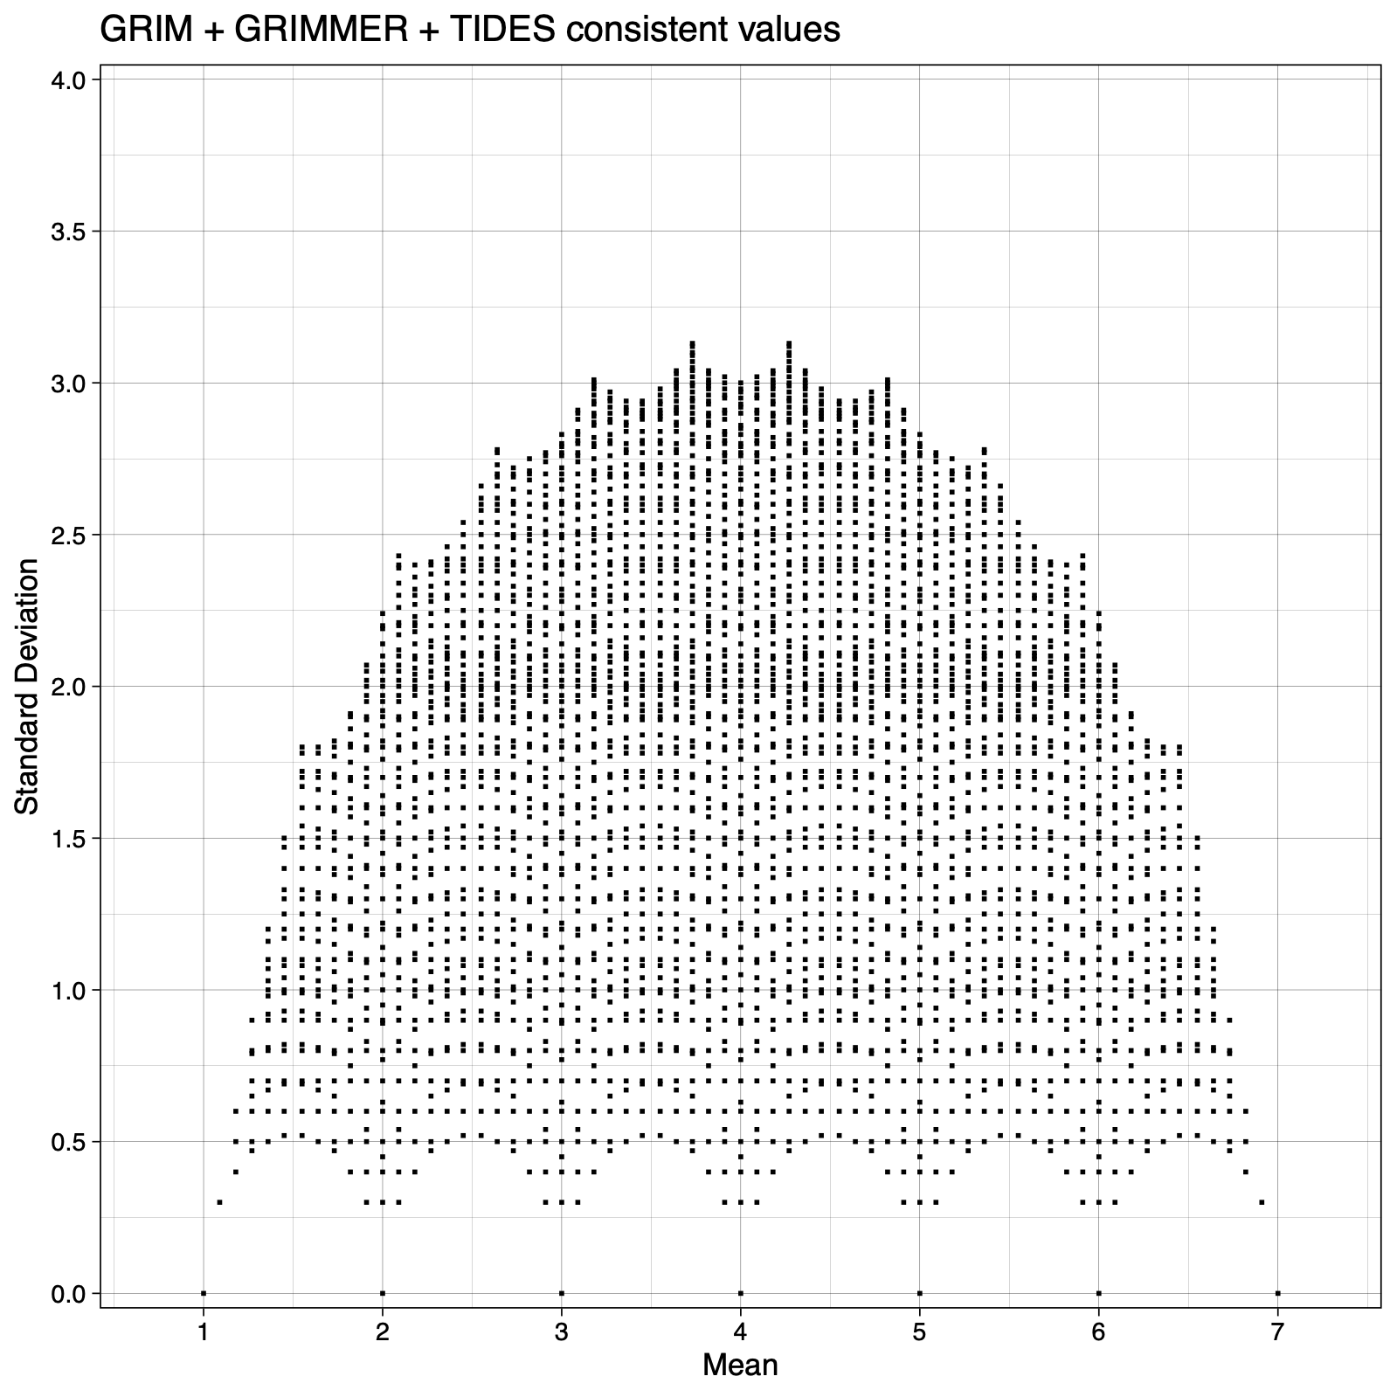
01.
Granularity + bounds tests
‘Umbrella’
plot
Heathers et al. 2017
N=11

Slide 14
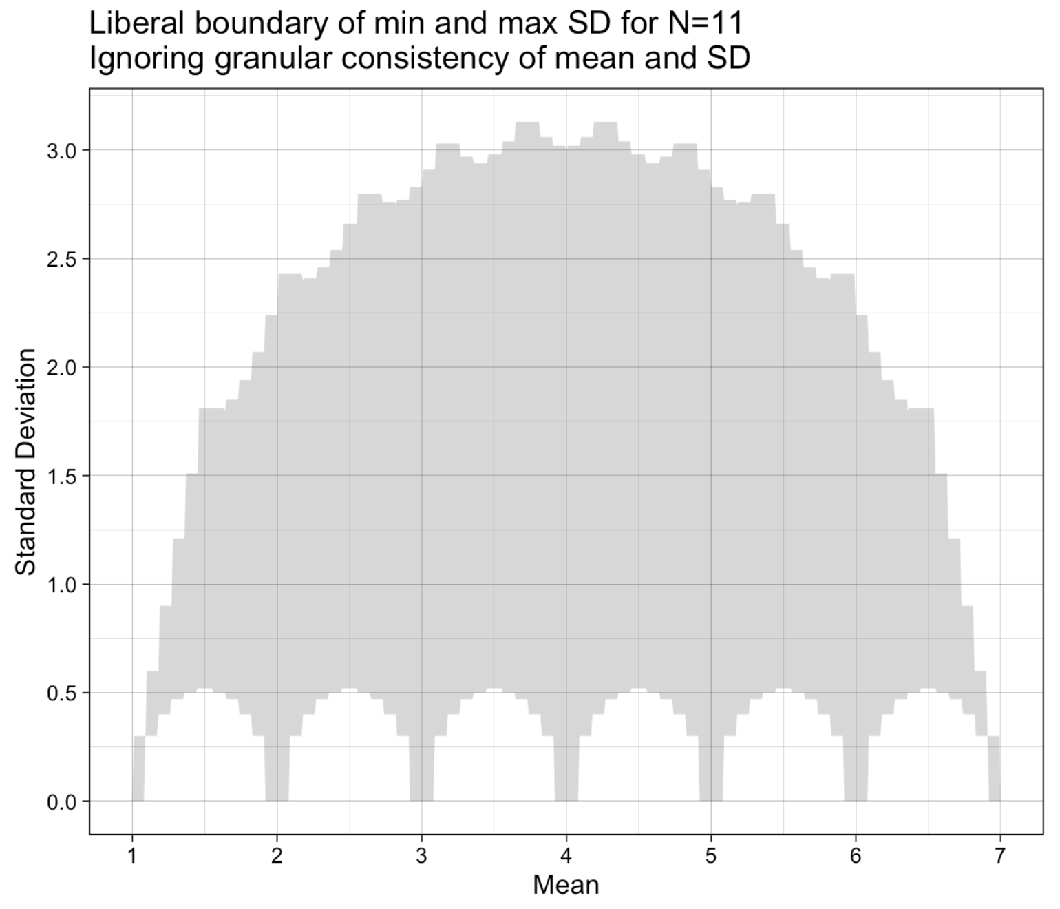
01.
TIDES
Truncation Induced DEpendencies among Summary statistics
Pacman
plot
Hussey et al. (in prep)
Mathematical
bounds of SD
for a given N and M

Slide 15
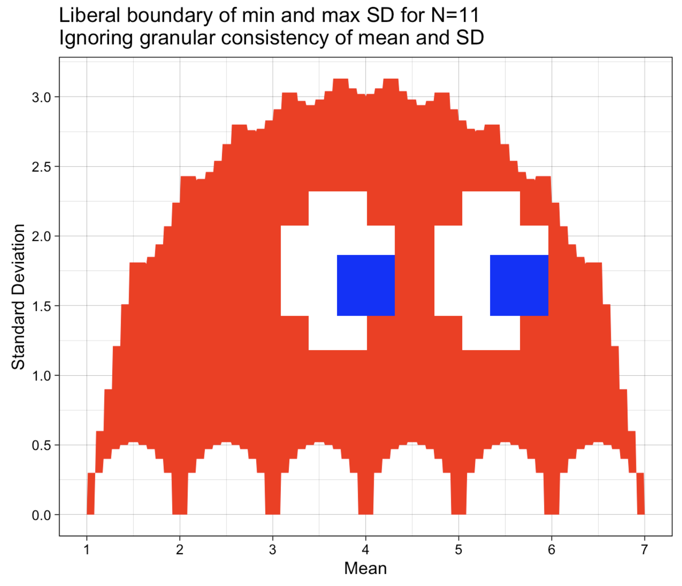
01.
TIDES
Truncation Induced DEpendencies among Summary statistics
Pacman
plot
Hussey et al. (in prep)
Mathematical
bounds of SD
for a given N and M

Slide 16
01.
TIDES
Truncation Induced DEpendencies among Summary statistics
Pacman
plot
Hussey et al. (in prep)
Mathematical
bounds of SD
for a given N and M
Standardized via Percent-Of-Maximum-Possible

Slide 17
01.
TIDES
Truncation Induced DEpendencies among Summary statistics
Pacman
plot
Hussey et al. (in prep)
Mathematical
bounds of SD
for a given N and M
0% Possible SD 100%
0% Possible Mean 100%
Standardized via Percent-Of-Maximum-Possible

Slide 18
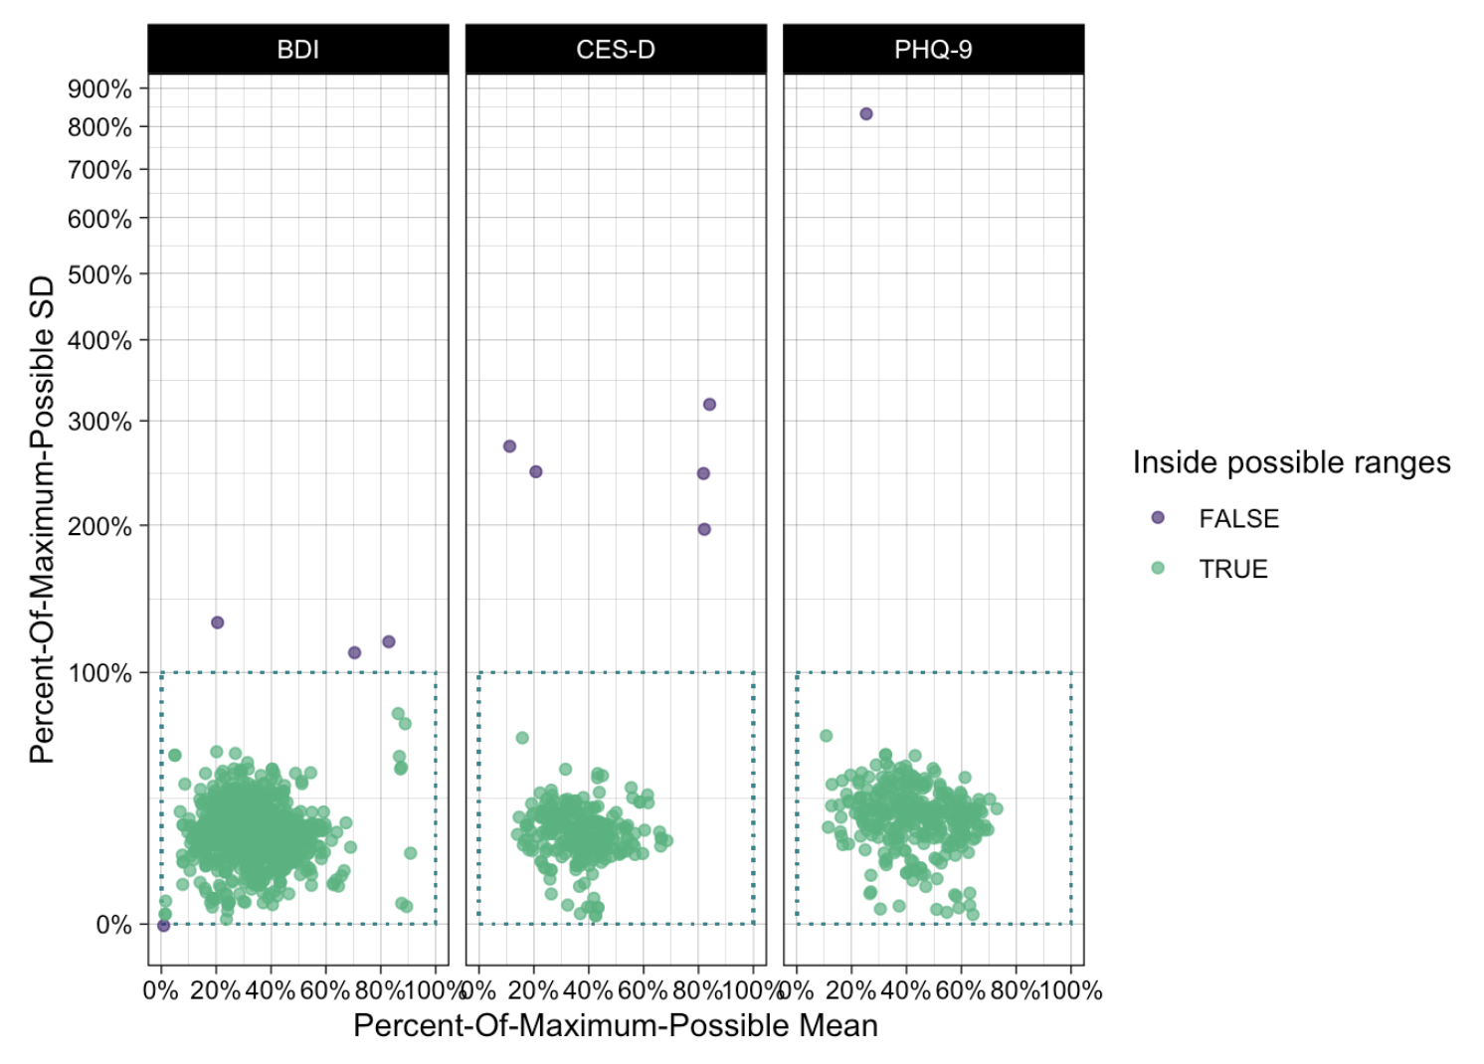
01.
TIDES
Truncation Induced DEpendencies among Summary statistics
TIDES POMP plot
Aids general intuitions
Lowers necessary expertise
metapsy database of RCTs on psychotherapy for depression

Slide 19
01.
TIDES
Truncation Induced DEpendencies among Summary statistics
TIDES POMP plot
Aids general intuitions
Lowers necessary expertise
metapsy database of RCTs on psychotherapy for depression
Some are impossible

Slide 20
01.
TIDES
Truncation Induced DEpendencies among Summary statistics
TIDES POMP plot
Aids general intuitions
Lowers necessary expertise
metapsy database of RCTs on psychotherapy for depression
Some are impossible
Others are implausible

Slide 21
01.
Error / trustworthiness checks
Expertise problem
Beck Depression Inventory (BDI-II)
N = 23, M = 20.70, SD = 3.40
errors.shinyapps.io/tides

Slide 22
01.
Error / trustworthiness checks
Expertise problem
Beck Depression Inventory (BDI-II)
N = 23, M = 20.70, SD = 3.40
Patient Health Questionnaire 9 (PHQ-9)
N = 20, M = 14.50, SD = 14.13
errors.shinyapps.io/tides

Slide 23

regcheck.app

Slide 24
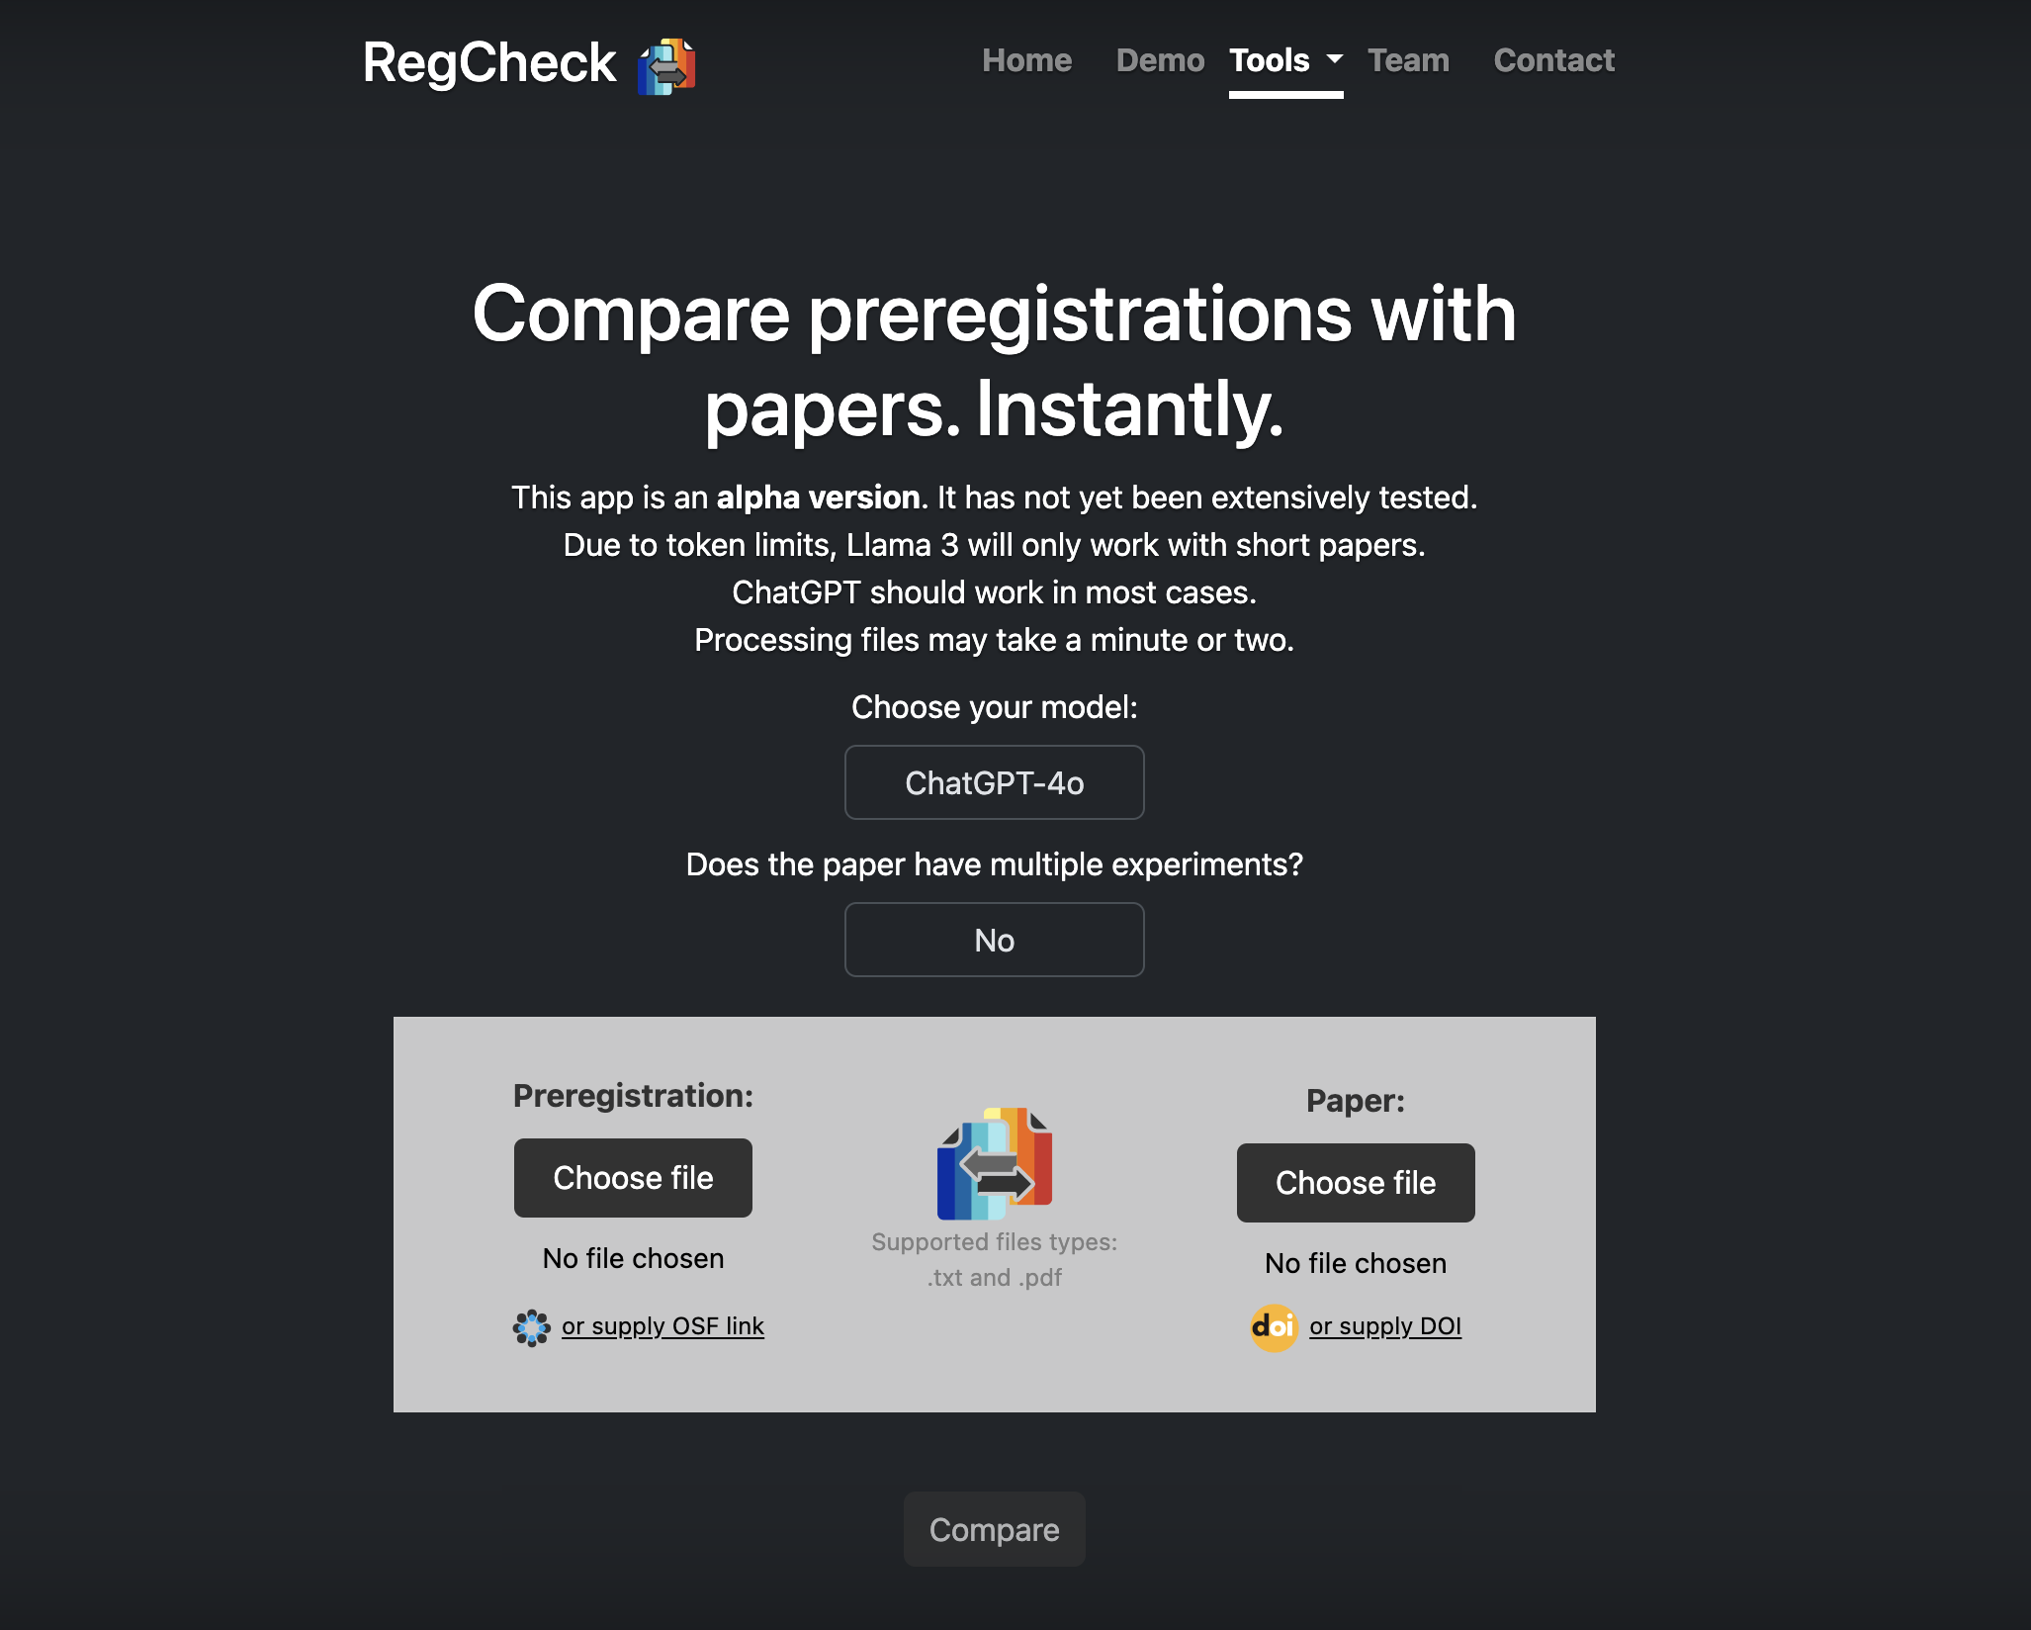
regcheck.app

Slide 25
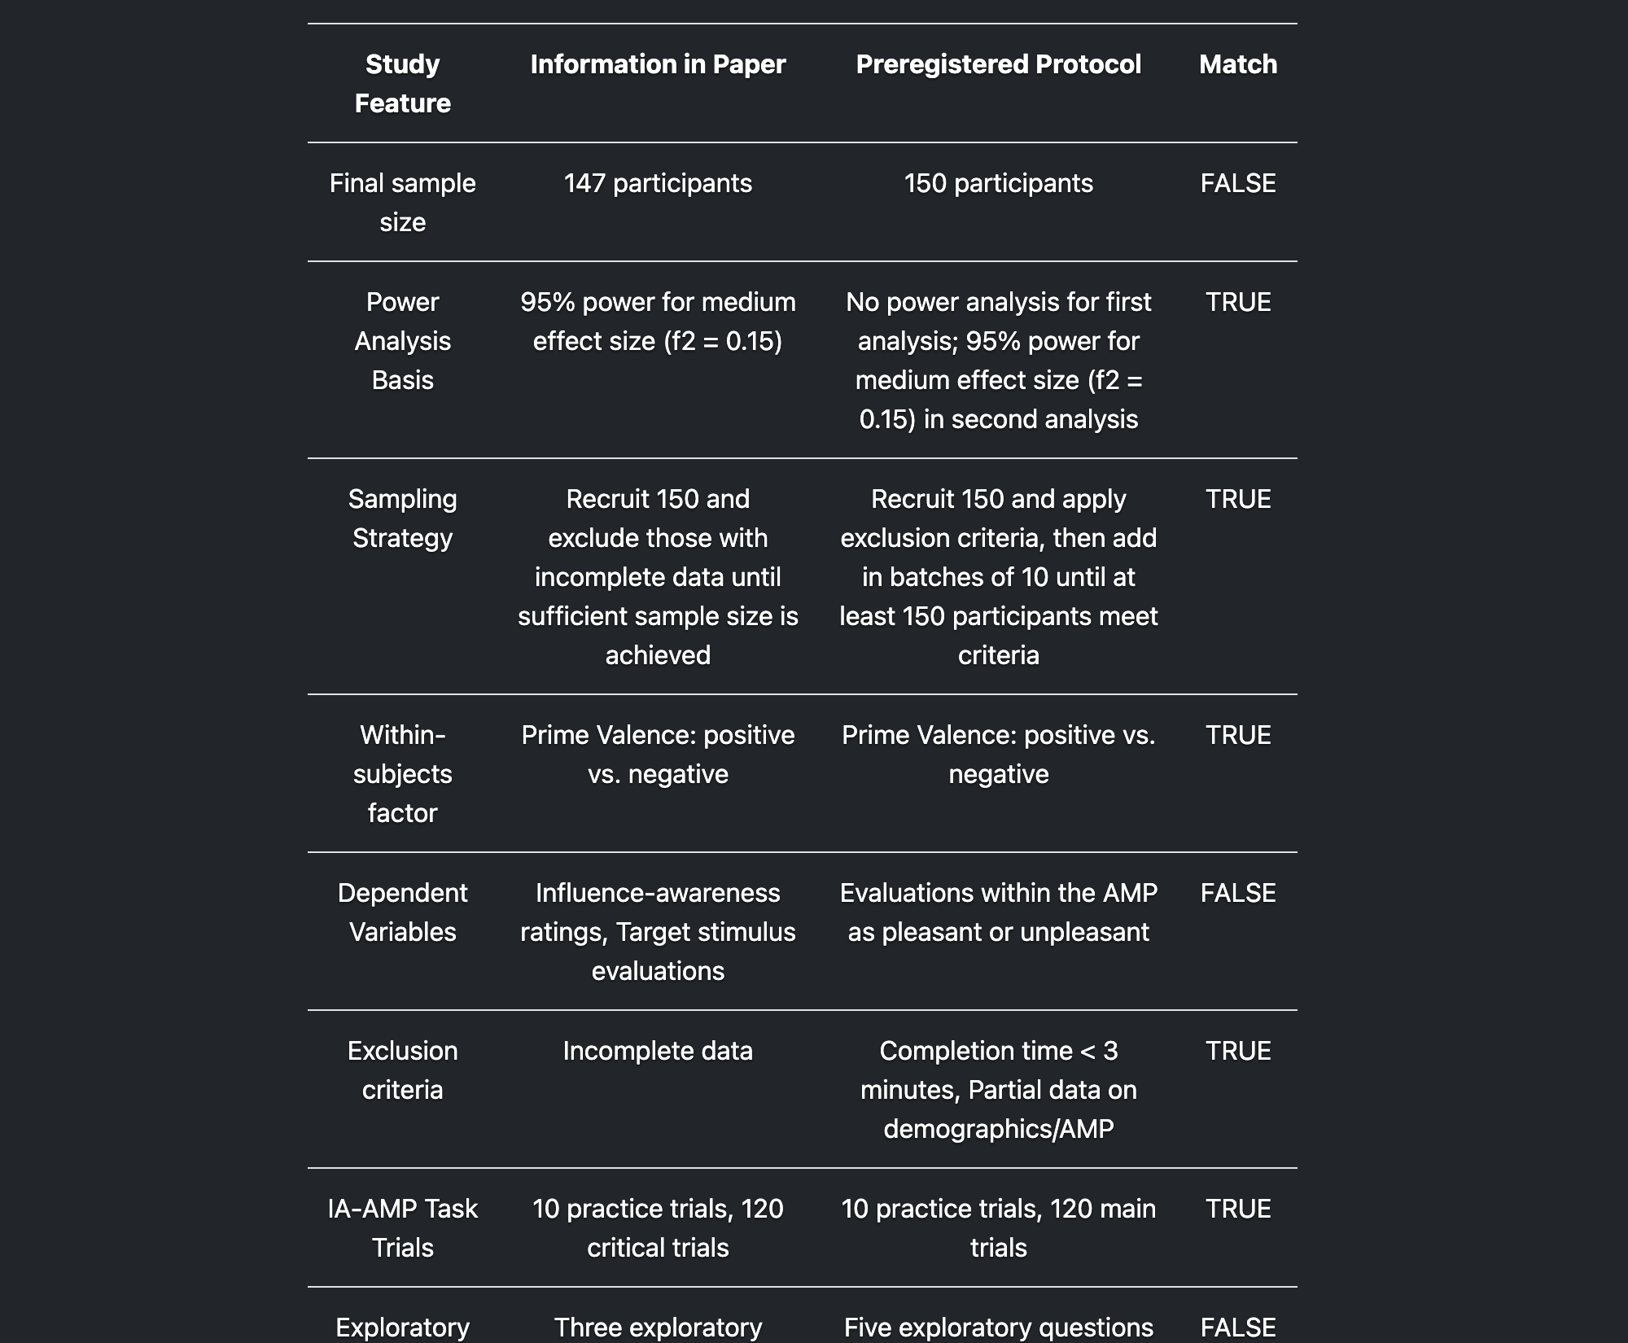
Validation against human-coded data in progress
API support for OSF and clinicaltrials.gov in progress
regcheck.app

Slide 26
In progress:
Validation against human-coded data
API support for OSF and clinicaltrials.gov
regcheck.app

Slide 27
A master’s degree course
in error detection
02.

Slide 28
02.
Conspicuous absence
of error detection in the curriculum
Defence against the dark arts:
a proposal for a new MSc course
(Bishop, 2023)

Slide 29
02.
“Estimating the credibility of past research”
14 week Masters course
Running at University of Bern since Fall ’23
Science as an intensely human & fallible activity
Organised skepticism

Slide 30
02.
Syllabus
Functions of science other than truth discovery
Existing quality assurance mechanisms in science and their flaws
StatCheck, GRIM, GRIMMER, TIDES, SPRITE, etc
Effect size plausibility
(Missing) causal language
Explanans/explanandum confusion
Jingle/jangle fallacies and measurement issues
Obtaining & extracting data
Organise and communicate critiques (INSPECT-SR, PubPeer)
Open Source materials will be released this spring!
Notes:
Srivistiva (2016) “Everything is fucked” syllabus
Bernal

Slide 31
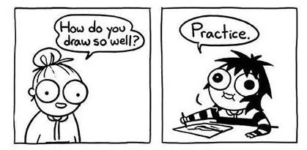
02.
Error check
Permission to critique
xxxxxxxxxx
Language of critique
Notes:
Day 1 I asked them questions about their knowledge of the replicability crisis, their belief about what proportion of the studies replicated etc.
Assignment 1 they wrote that science is entirely self correcting, errors are rare, there is no problem
Student feedback
Error checking increases understanding of statistics
They want this information earlier in their studies

Slide 32
ERЯOR
A bug bounty program for science
03.

Slide 33


Slide 34
250,000 CHF
(€260k, $285k)
fund

Slide 35
Check
100
published articles
for errors

Slide 36
Pay authors & reviewers
+ bonus rewards
contingent on errors found
+ offer co-authorship of umbrella publications

Slide 37
Goals
౿
Explore and test practical challenges in the
implementation of an error checking system
౿
Obtain empirical estimates of the
the prevalence of errors and their types
cf. OSC (2015) Estimating the Reproducibility of Psychological Science
౿
Intervention on our scientific culture around errors
Providing positive examples of scientists self-correcting
Specify reinforcers for error acceptance
Extinguish perceived punishers

Slide 38
Selected for ‘importance’ Would matter if it contained errors. 30+ citations per year. Recent (c.10 years)
Not randomly sampled
Attention paid to gender, seniority, etc.
01.
Candidate articles
02.
Obtain author consent
03.
Match with reviewer

Slide 39
Consensual process
Pre-commit to:
Sharing materials
Answering reasonable questions
Acting on recommendations
01.
Candidate articles
02.
Obtain author consent
03.
Match with reviewer

Slide 40
Not anonymous
Can ask author reasonable questions to aid their work
01.
Candidate articles
02.
Obtain author consent
03.
Match with reviewer

Slide 41
Checked by Recommender
- Claims must be substantiated
04.
Review
05.
Author response
06.
ERROR Report

Slide 42
Optional, timely
Checked by Recommender
- Claims must be substantiated
04.
Review
05.
Author response
06.
ERROR Report

Slide 43
Recommender makes a Decision & associated Recommendation(s)
Published
error.reviews website
PsyArXiv
PubPeer
CC-By 4.0 licence
04.
Review
05.
Author response
06.
ERROR Report

Slide 44
Decision | Recommendation | Bonus reward (indicative)
No errors | No additional action beyond publication of error report on the error.reviews website. | 250 CHF to the author
Minor error(s) | Authors to appropriately recognise these errors in future discussions of the article. Probably most research! | 250 CHF to both the author & reviewer
Indeterminable error(s) | No determination could be made re the presence or absence of important potential errors. Less desirable than verifiably minor errors! Authors to appropriately recognise this lack of verifiability in future discussions of the article. | 250 CHF to the reviewer
Moderate error(s) | Correction notice (minor) | 500 CHF to the reviewer
Major error(s) | Correction notice (major) / may warrant an expression of concern | 1000 CHF to the reviewer
Severe error(s) | Retraction | 2500 CHF to the reviewer
+ error(s) do / do not affect core conclusions

Slide 45
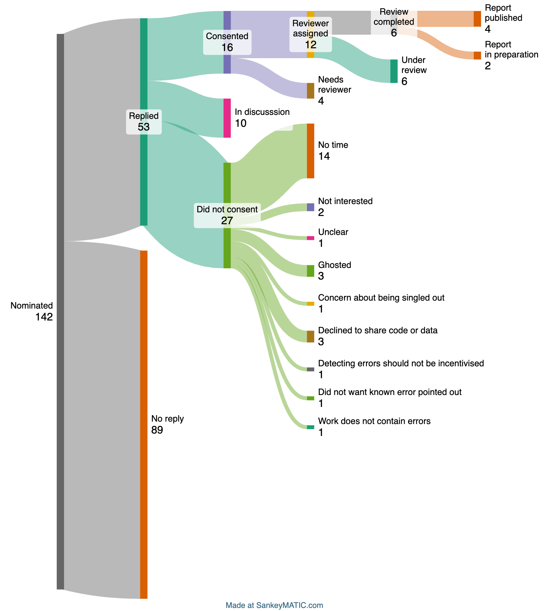





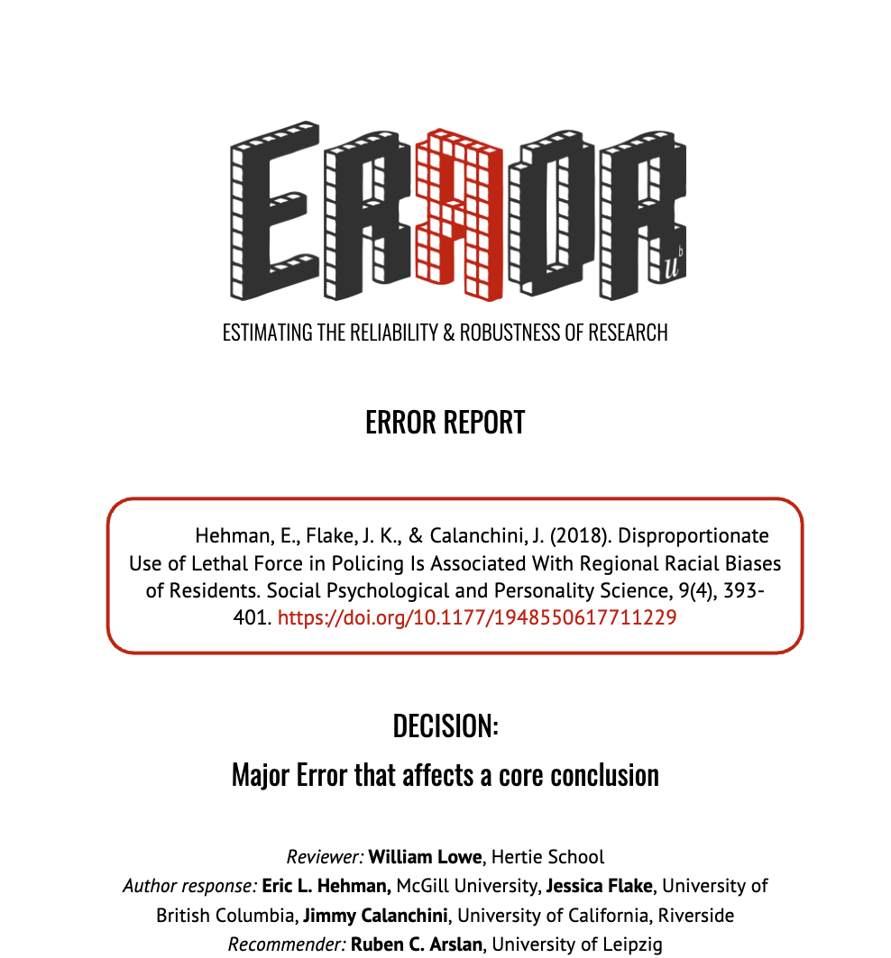
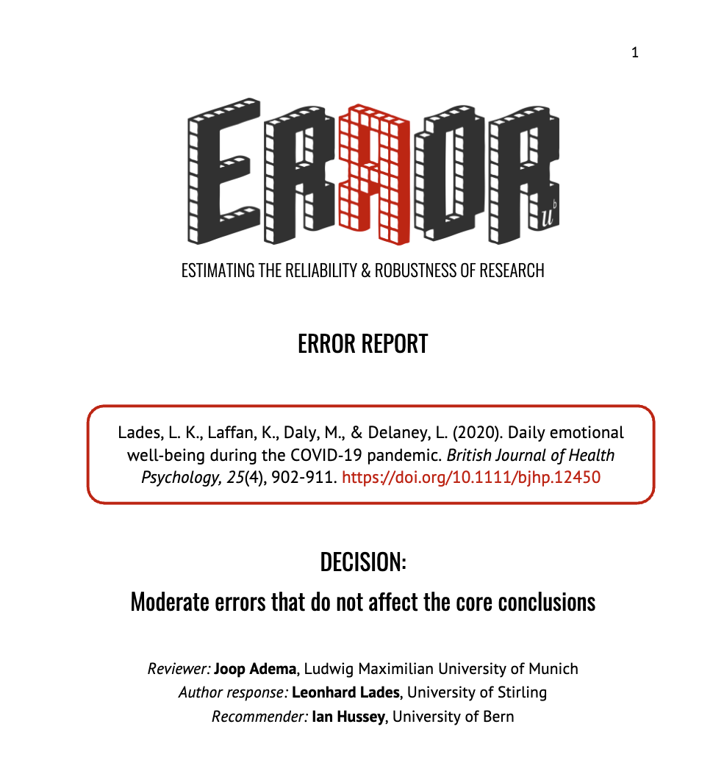

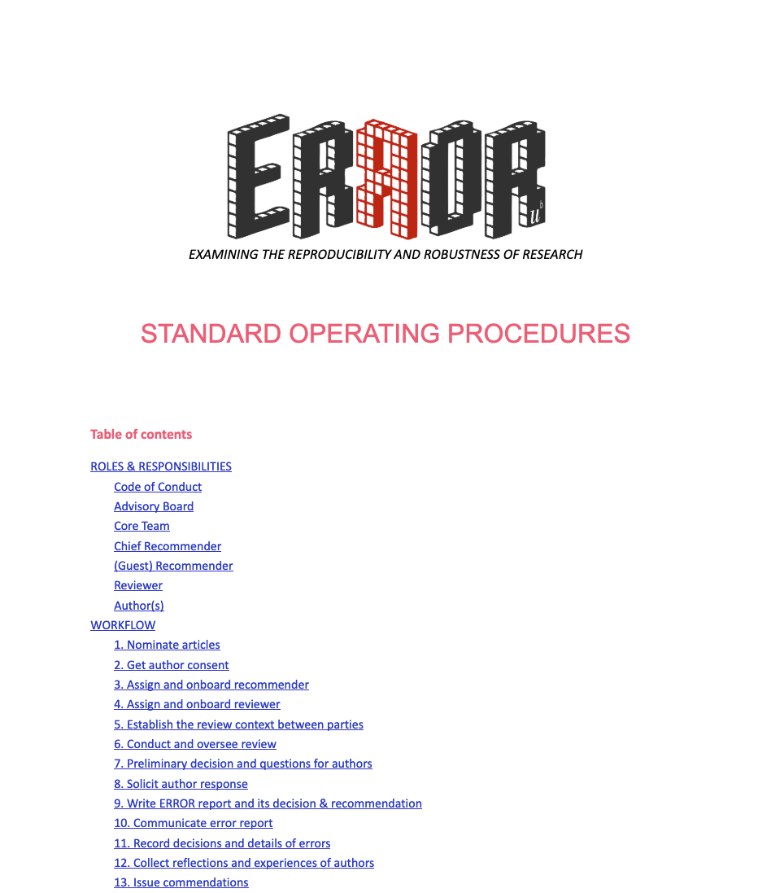

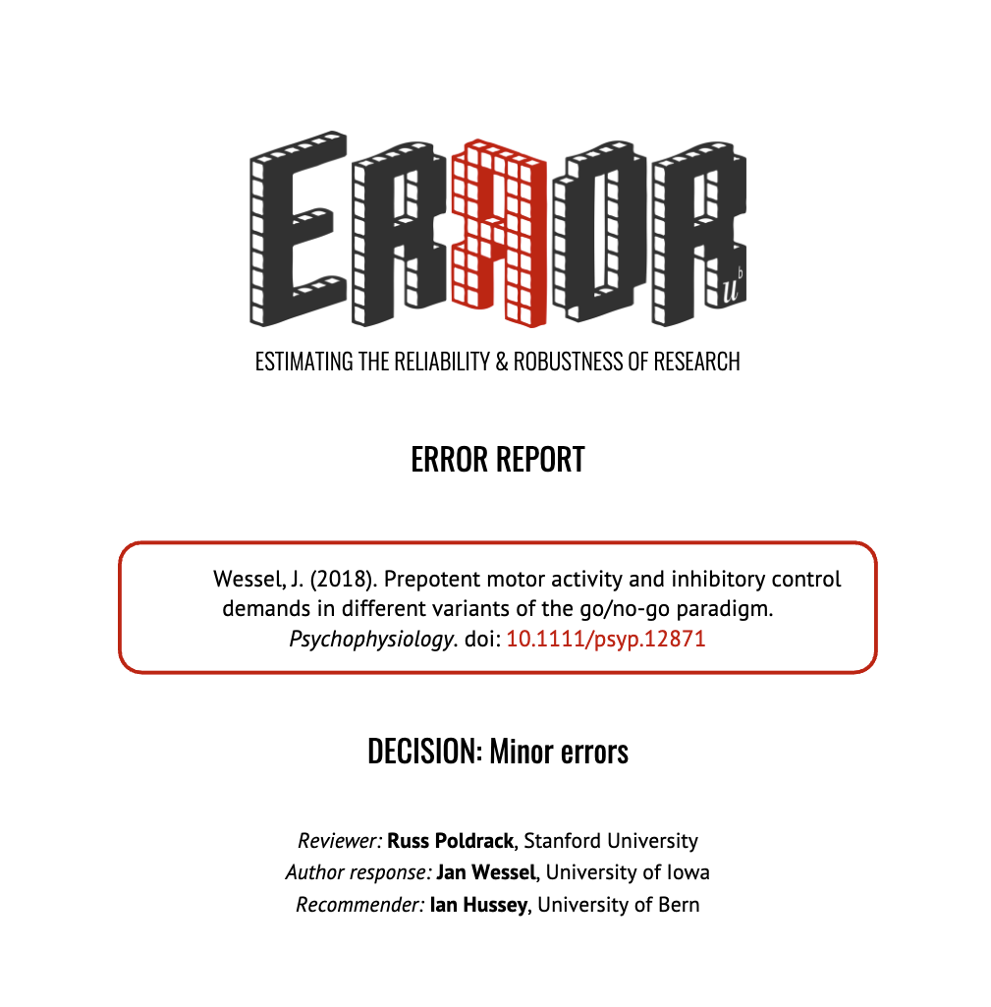
Snapshot of activities at
1 year

Slide 46
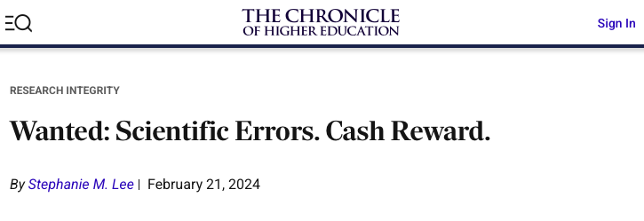
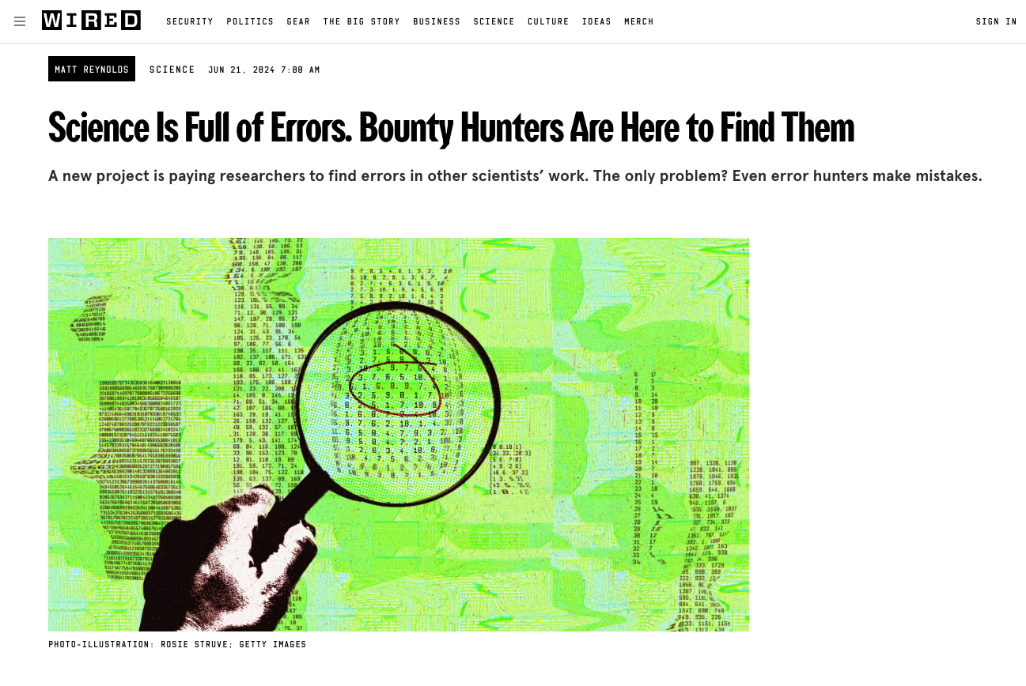
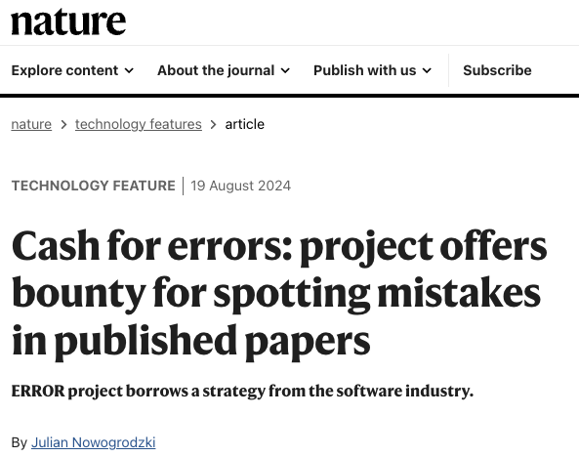
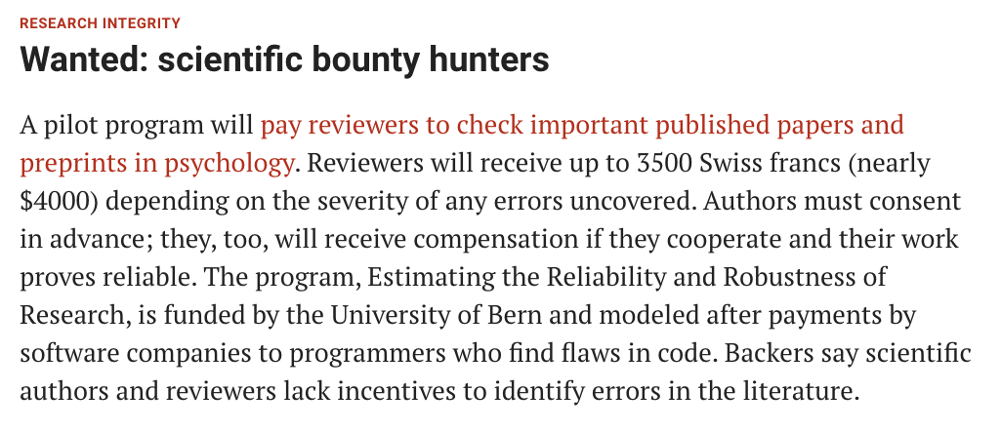
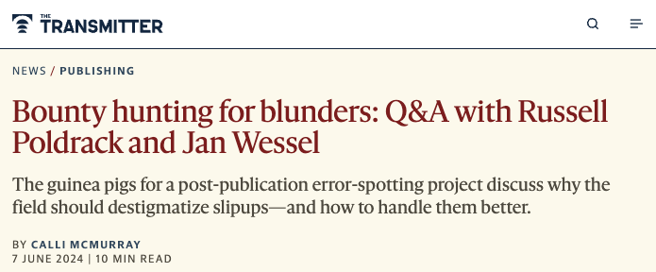

Slide 47
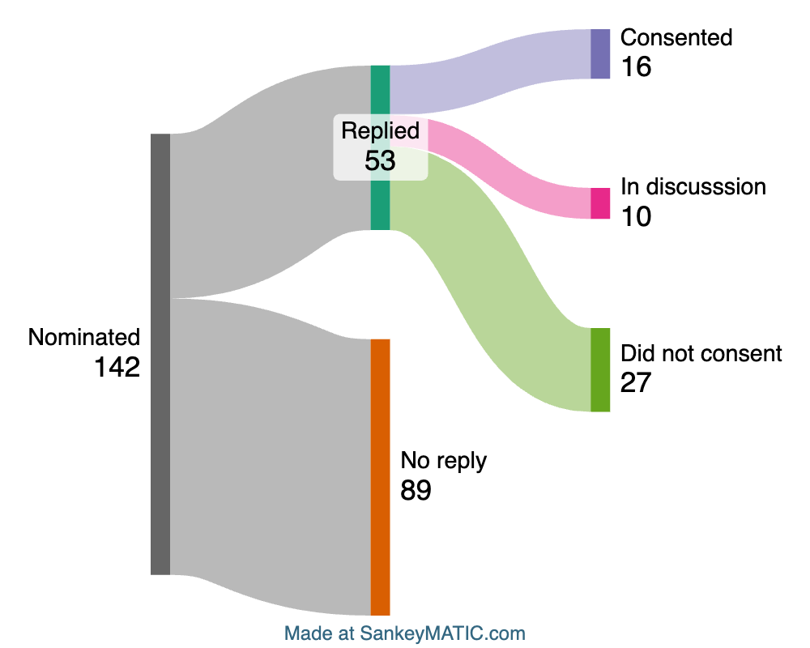

Slide 48
Response rate
37%
Consent rate
11%
(30% of responders)

Slide 49
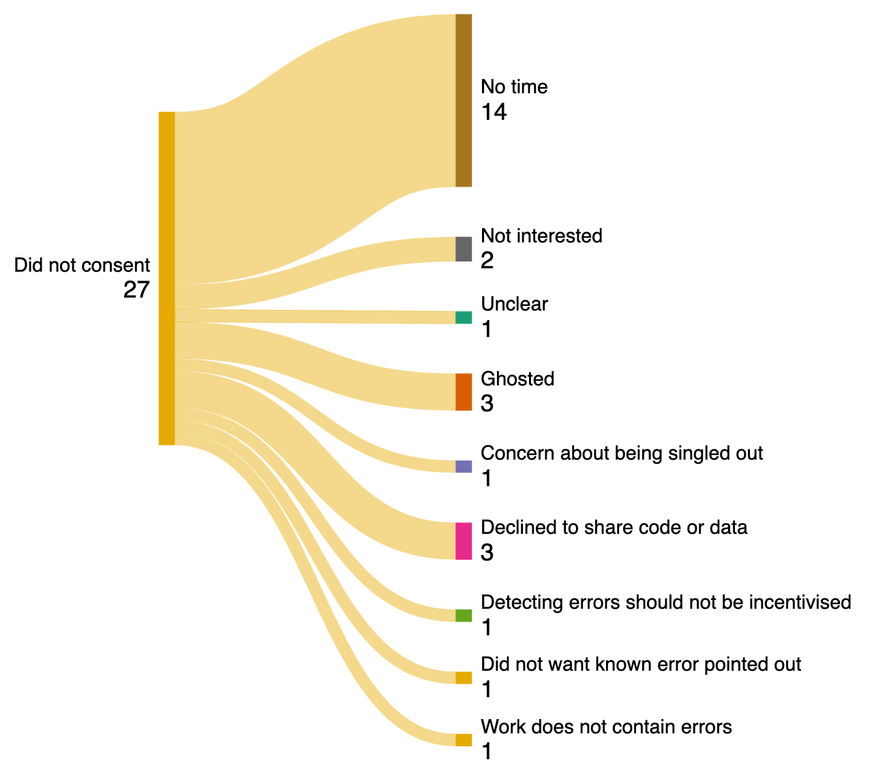
Reasons
for non-consent

Slide 50
Reasons
for non-consent

Slide 51
Reasons
for non-consent

Slide 52
Reasons
for non-consent

Slide 53
Reasons
for non-consent

Slide 54
Reasons
for non-consent
Reasons we find
difficult to defend:
22%
of responders
(4% of nominated)

Slide 55
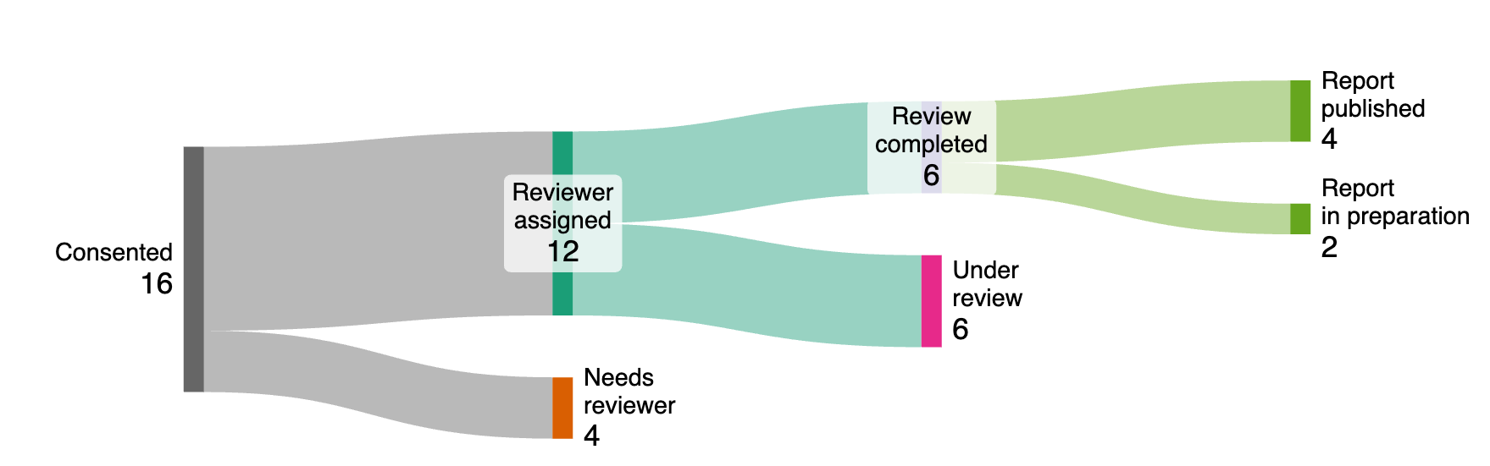
Difficulty finding reviewer or
completing review
25%
Notes:
WE ACCIDENTALLY STARTED A JOURNAL, TURNS OUT THAT’S HARD

Slide 56
Building momentum
- Guest Recommenders
- Explicated processes

Slide 57
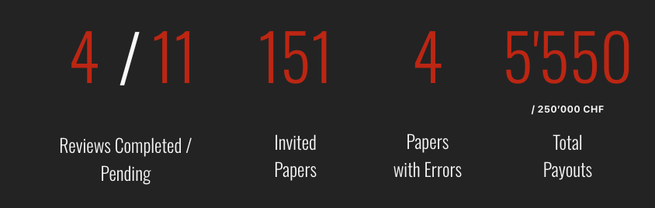

Slide 59
Decisions & Recommendations
౿
Minor Errors that do not affect the core conclusions
2 articles
౿
Moderate Errors that do not affect the core conclusions
1 article
౿
Major Errors that affect the core conclusions
1 article

Slide 60
Decisions & Recommendations
౿
Minor Errors that do not affect the core conclusions
2 articles
- No correction recommended, but 1 author seeks one anyway
౿
Moderate Errors that do not affect the core conclusions
1 article
- Correction recommended, but unclear if authors will act
౿
Major Errors that affect the core conclusions
1 article
- Correction recommended, but unclear if authors will act

Slide 61
Common Errors Encountered
[very preliminary]
౿
Non-significant p values treated as evidence for the null
౿
Poor reproducibility in early stages of data cleaning/processing
౿
Informally: Prevalence of not-even-wrong claims

Slide 62

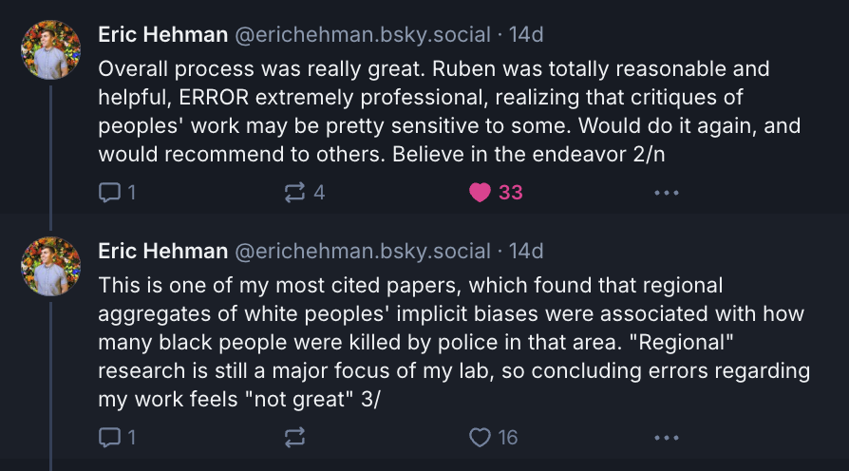
Experiences & Reactions

Slide 63

Experiences & Reactions

Slide 64
Our strategy to increase error
checking, reporting, & correction
Make it required
Make it required
Policy
ERЯOR
rewards
Make it rewarding
Make it rewarding
Communities
& teaching
Make it normative
Make it normative
Discoverable & usable
error detection methods
Make it easy
Make it easy
Availability of data & code
Existence of error detection methods
Make it possible
Make it possible

Slide 65
Many thanks to
Collaborators
Ruben Arslan
Jamie Cummins
Malte Elson
ERROR Advisory Board
Authors & Reviewers
Joop Adema
Jimmy Calanchini
Jessica K. Flake
R. Chris Fraley
Eric Hehman
Leonhard Lades
Nick Light
Will Lowe
Russ Poldrack
Jan Wessel
Contact
ian.hussey@unibe.ch
Bluesky: @ianhussey.bsky.social
https://error.reviews
error-reviews.psy@unibe.ch
Bluesky: @error.reviews

